Slide 1
PneuMatrix
Building Adaptive
Change Leadership

Slide 2
Post-pandemic Congregational Vitality:
Learning to Flex our Adaptive Muscles

Slide 4
The Adaptive Change Challenge
Technical challenges are problems we know we have the answers to.
Adaptive challenges are problems we have no idea how to solve.
When faced with technical change,
Best practices are your friends.
When faced with adaptive change,
Best practices are your nemeses.

Slide 5
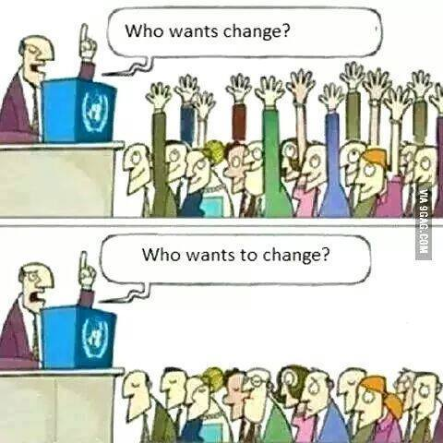

Slide 6
Christianity in America
Pre-pandemic
Post-Christendom
Post-pandemic – what we know so far . . .

Slide 7
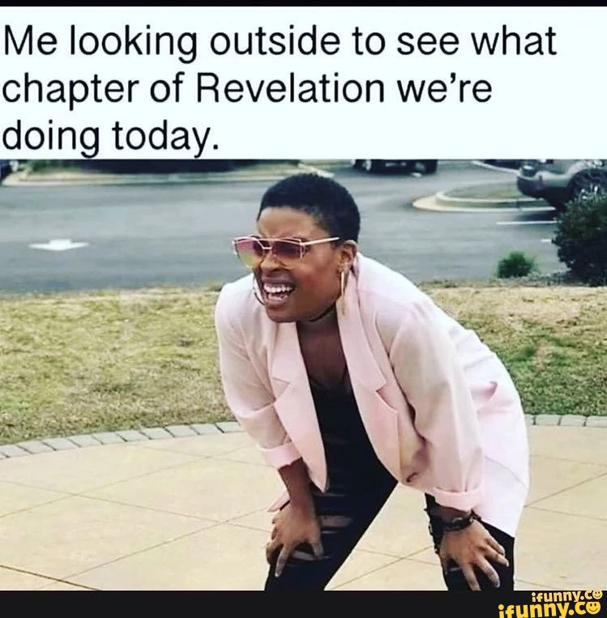

Slide 8
“If we DO NOTHING DIFFERENT, by 2040* all of our current churches sized 100 and less will be gone and we will be a denomination of 500,000 members.” Dr. Bill Drummond, Professor of Urban Analytics, GA Tech, PCUSA MWS * Post-COVID, Bill has revised this to 2030

Slide 9
Exodus 1: 1-14
The beginning of a long journey into the Unknown

Slide 11
Signs of the ‘Rummage Sale’
All in the Family
Religion in America –
the NONES & the DONES
Growth of the Non-Joiner Generations
Christianity – “the Brand”
22 churches close in America every DAY!
The Sunday-centric Syndrome

Slide 14
NONES
DONES
CHURCHED

Slide 15
Diana Butler- Bass:
Path to becoming part of a Family of Faith
Old Path :
Believe Behave Belong
New Path:
Belong Behave Believe

Slide 16
Portals of Entry in a Post-Pandemic church
Non-Sunday-centric
Learn what it feels like to be the “Other” -2 ‘mystery shopper’ tools
Theology Pub, Panera w/ the pastor, etc.
Increasing your Civic presence
Truth of the 86%!!
Redefining Membership
Looking OUTWARD!

Slide 17
Degrees of Missional Engagement – The Baseball Diamond
2nd - We do something WITH them
3rd - We invite them BESIDE us
1st - We do something FOR them
Home Plate – ‘We’ and ‘Them’
becomes ‘US’

Slide 18
“Culture Eats Strategy for Breakfast” Peter Drucker

Slide 19
Animal Farm A Game of Truth-telling

Slide 20
Peacock
What about your church makes
you proud as a peacock?

Slide 21
Sacred Cow
What do we treat as that which cannot be "messed with" in our church?
Notes:
Use examples from Emsworth here.
Worship time/day
Building
Music
Sanctuary “feel”

Slide 22
Elephant in the Room
What issues need to be acknowledged and discussed that we are afraid to tackle?
Notes:
Hollow enthusiasm/lack of commitment
Change that takes us out of our comfort zone
Will people leave if we change?

Slide 23
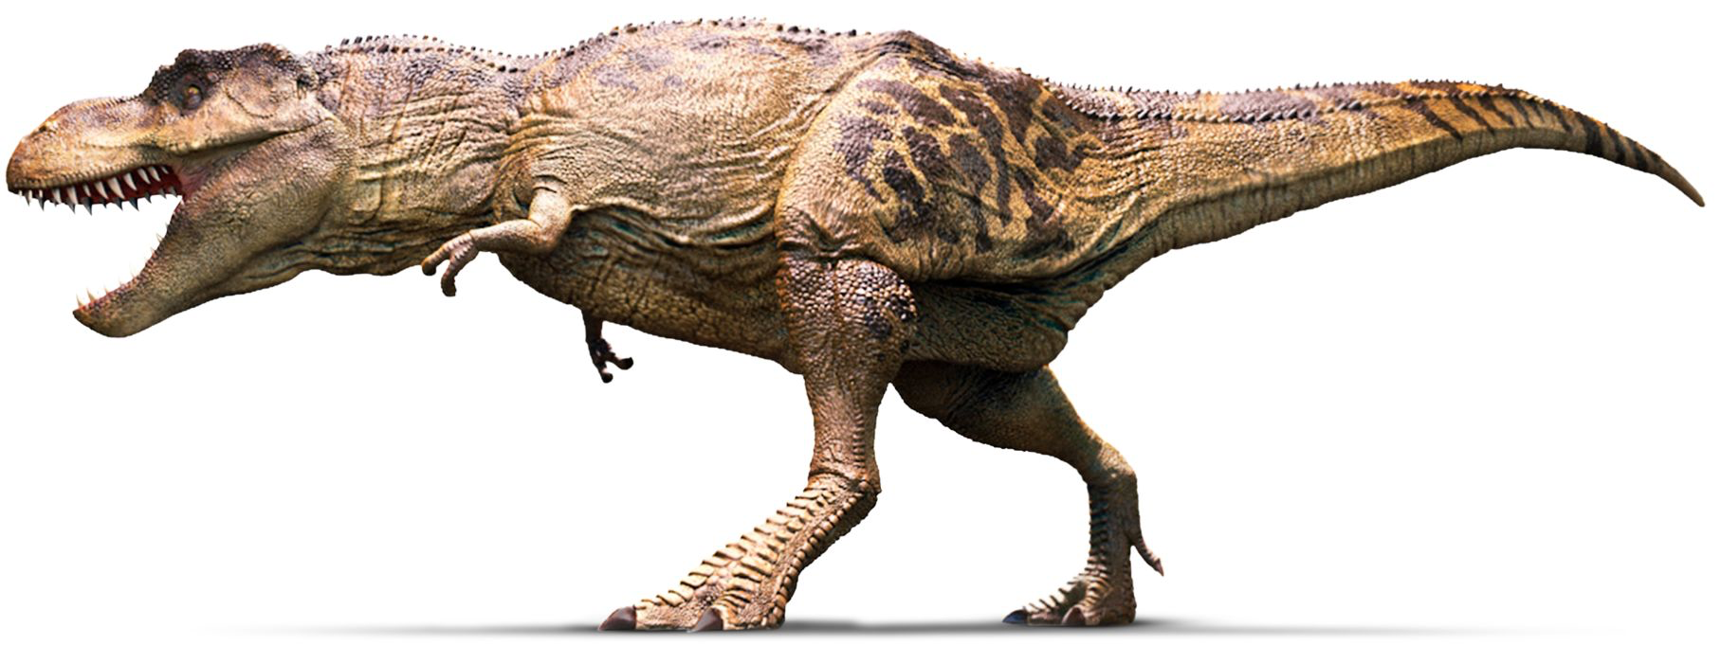
#Dinosaur
Dinosaur
What is extinct, or needs to die in order to move forward?

Slide 24
Squirrel
What distractions are keeping us from our task?

Slide 25
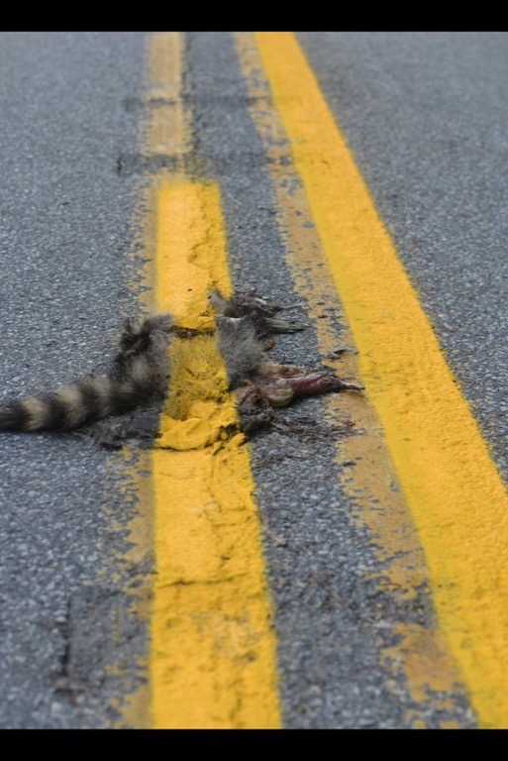
Road Kill
Naming and embracing
our epic failures.

Slide 26
Nest Eggs
What NEW things are you hoping for Post-Pandemic in your church?

Slide 27
As elders and deacons we promised to “… serve the church with energy, intelligence, IMAGINATION, and love.”

Slide 28
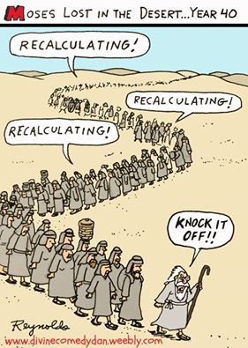

Slide 30
#SacredCow
AKA The Golden Calf – what do we treat as ‘that which cannot be messed with’?

Slide 31
#Elephant
. . . in the room, that needs to be acknowledged and discussed

Slide 32
#Dinosaur
What is extinct, or needs to die in order to move forward?

Slide 33
#Squirrel
What distractions are keeping us from our task?

Slide 34
#Roadkill
Name and embrace our epic failures

Slide 35
#Nest
What New Things do you want for your church?

